Slide 1
PROGRAMMING AND COMPUTATION 1
Assist.Prof.Dr.Murat ŞİMŞEK

Slide 2
Context-Week1
• Introduction to the course and syllabus overview.
• What is a program? What is a programming language?
• Historical context and evolution of programming languages.
• Tutorial on setting up the programming environment and IDE installation.
Notes:
Welcome to the "Introduction to Programming" course! In this course, we will explore the fundamentals of programming and learn how to write programs using Python. Our goal is to equip you with the skills necessary to solve real-world problems through programming. This course will cover both the theoretical aspects of programming and hands-on experience with Python, one of the most versatile and widely-used programming languages today.

Slide 3
Contribution
Mid-term Exam %40
Final Exam %60

Slide 4
What is a Program? What is a Programming Language?
A program is a set of instructions that a computer follows to perform a specific task.
These instructions can range from simple calculations to complex decision-making processes.
A programming language is a formal language used to write these instructions in a way that a computer can understand.
Different programming languages offer different tools and techniques to solve problems efficiently.
Python, which we will use in this course, is known for its simplicity and readability, making it an excellent choice for beginners.
Notes:
Welcome to the "Introduction to Programming" course! In this course, we will explore the fundamentals of programming and learn how to write programs using Python. Our goal is to equip you with the skills necessary to solve real-world problems through programming. This course will cover both the theoretical aspects of programming and hands-on experience with Python, one of the most versatile and widely-used programming languages today.

Slide 5
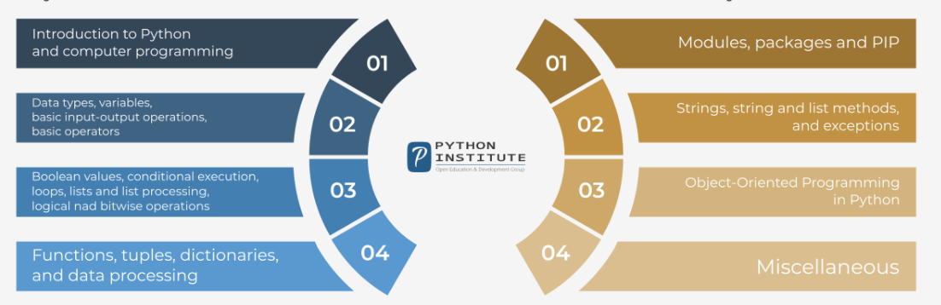
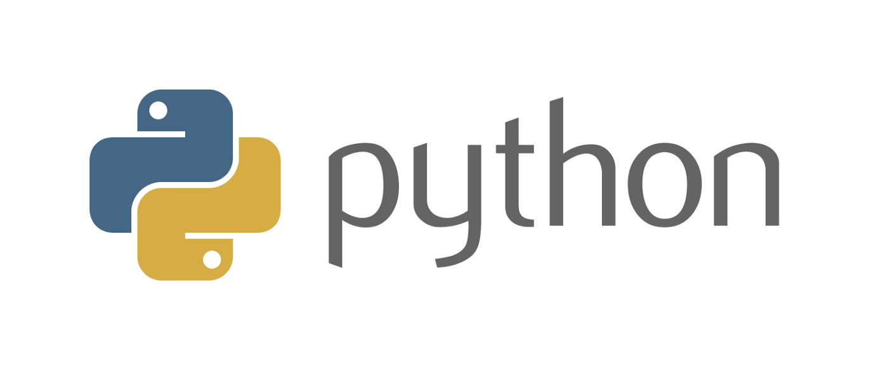
Python Programming

Slide 6
Python Programming
Python is a widely-used, interpreted, object-oriented, and high-level programming language with dynamic semantics, used for general-purpose programming.

Slide 7
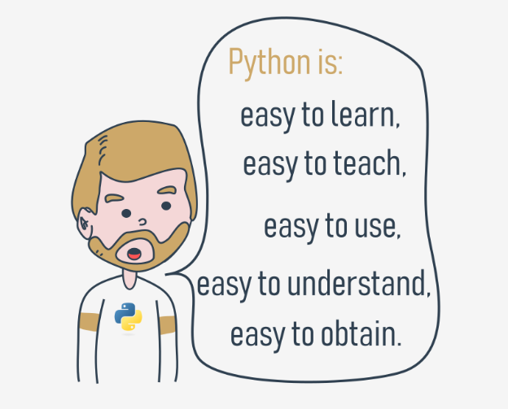
Python Programming

Slide 8
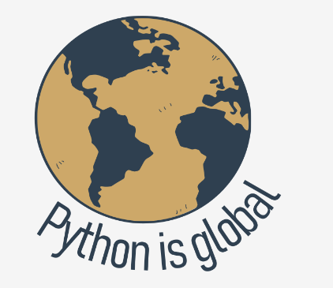
Python Programming

Slide 9
Python Programming
practice
Practice
Practice
Practice
Practice
Practice
Practice
Practice
Practice
Notes:
For this course, we will use Google Colab as our Integrated Development Environment (IDE). Google Colab is a cloud-based platform that allows you to write and execute Python code without needing to install anything on your local machine. It provides a simple interface, automatic saving, and access to powerful computing resources, making it an ideal environment for learning. To get started, all you need is a Google account. We will walk through setting up Colab, creating your first notebook, and understanding its basic features in our first tutorial.

Slide 10
Python Programming
practice
Practice
Practice
Practice
Practice
Practice
Practice
Practice
Practice

